Slide 1
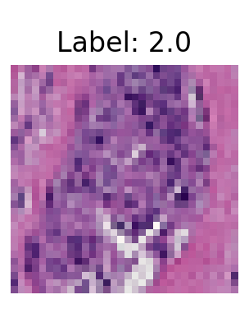
CNN Vs RNF for Breast Cancer Image Classification
Dylan Boles
Notes:
nneo (2)

Slide 2
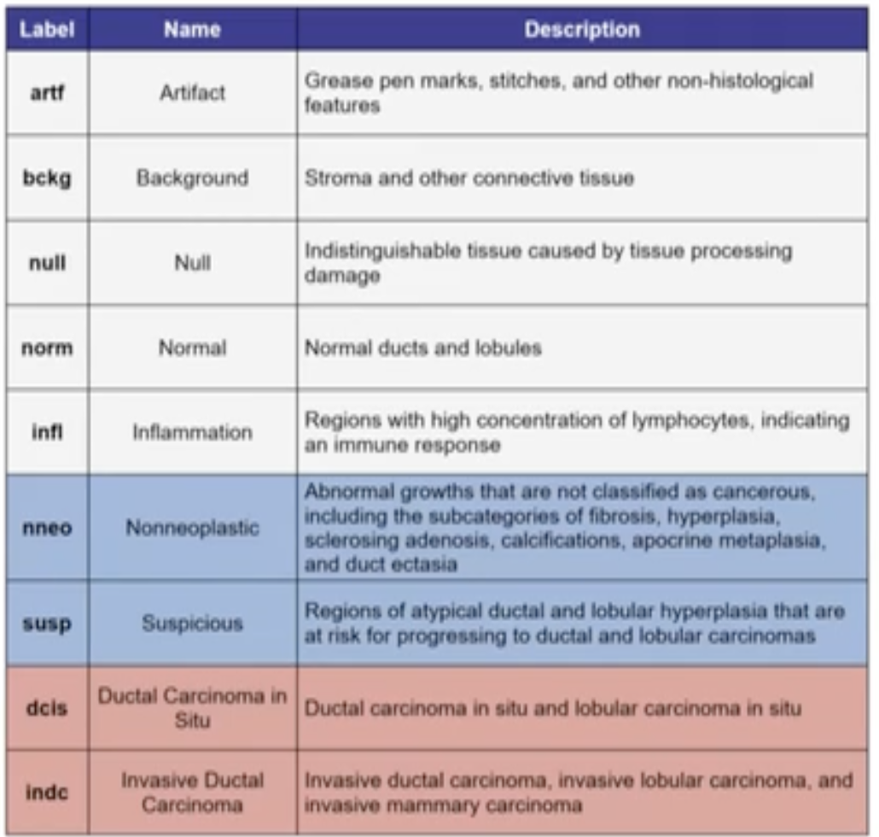
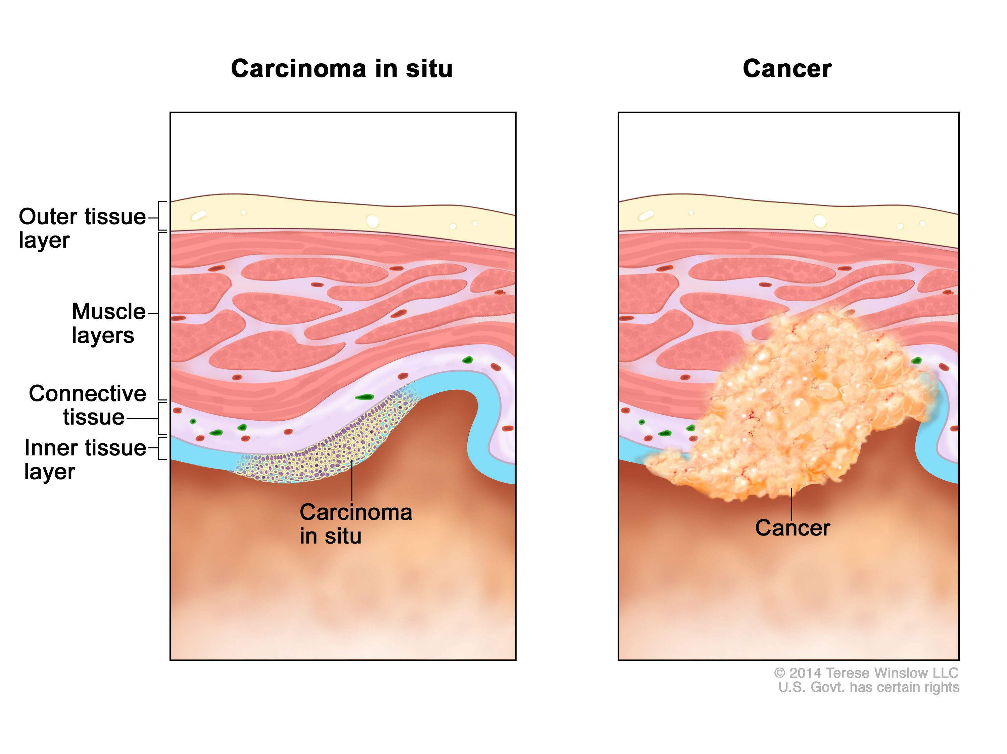
Dataset
Classify Images on 9 Labels
Importance to Pathologists
Objective
RNF
CNN
Feeding CNN actual images
RNF is computationally efficient
Notes:
3505 images
Image Form in the Spactial Domain not Freq

Slide 3
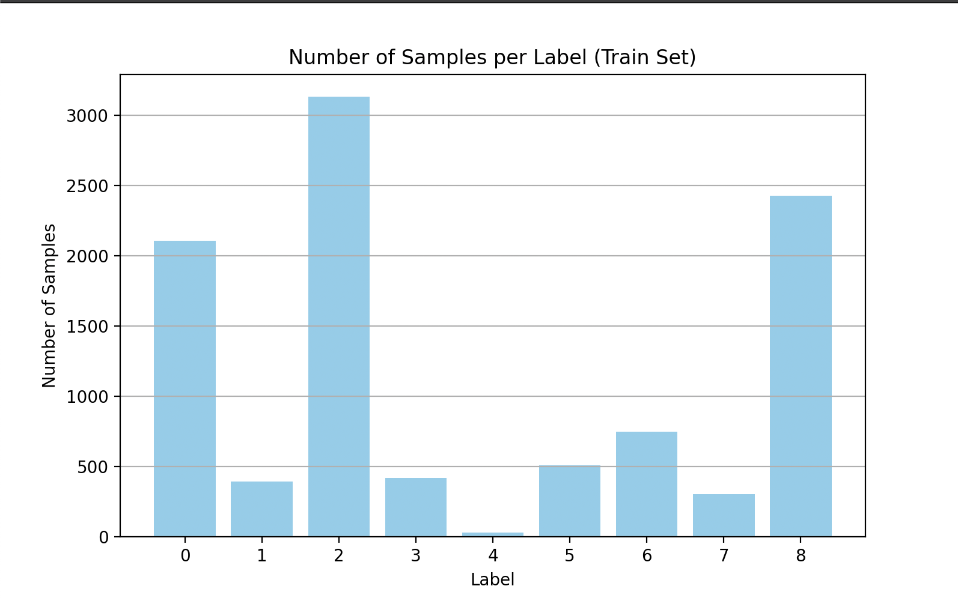
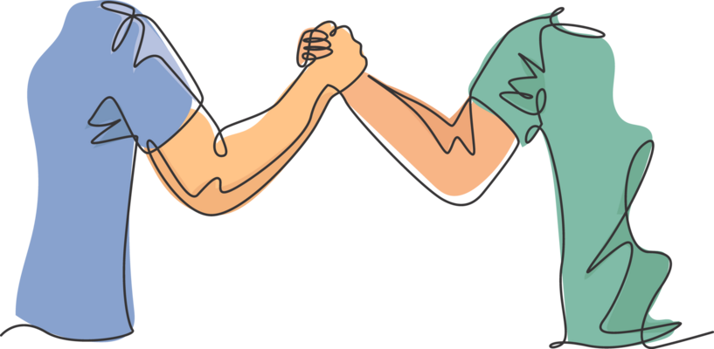
Preprocessing
CNN | RNF
Inverse Discrete Cosine Transform (IDCT) | Discrete Cosine Transform (DCT)
Weighted Cross Entropy | Class Weighting Sklearn parameter
Data Augmentation | Better with Frequency
Set the Mean and Standard Div to the imageNet dataset this helped with generlization | Use calculated mean and Standard Deviation to Standardize
Class Imbalance
Training
Dev
+
Notes:
Stadardize Scaler

Slide 4
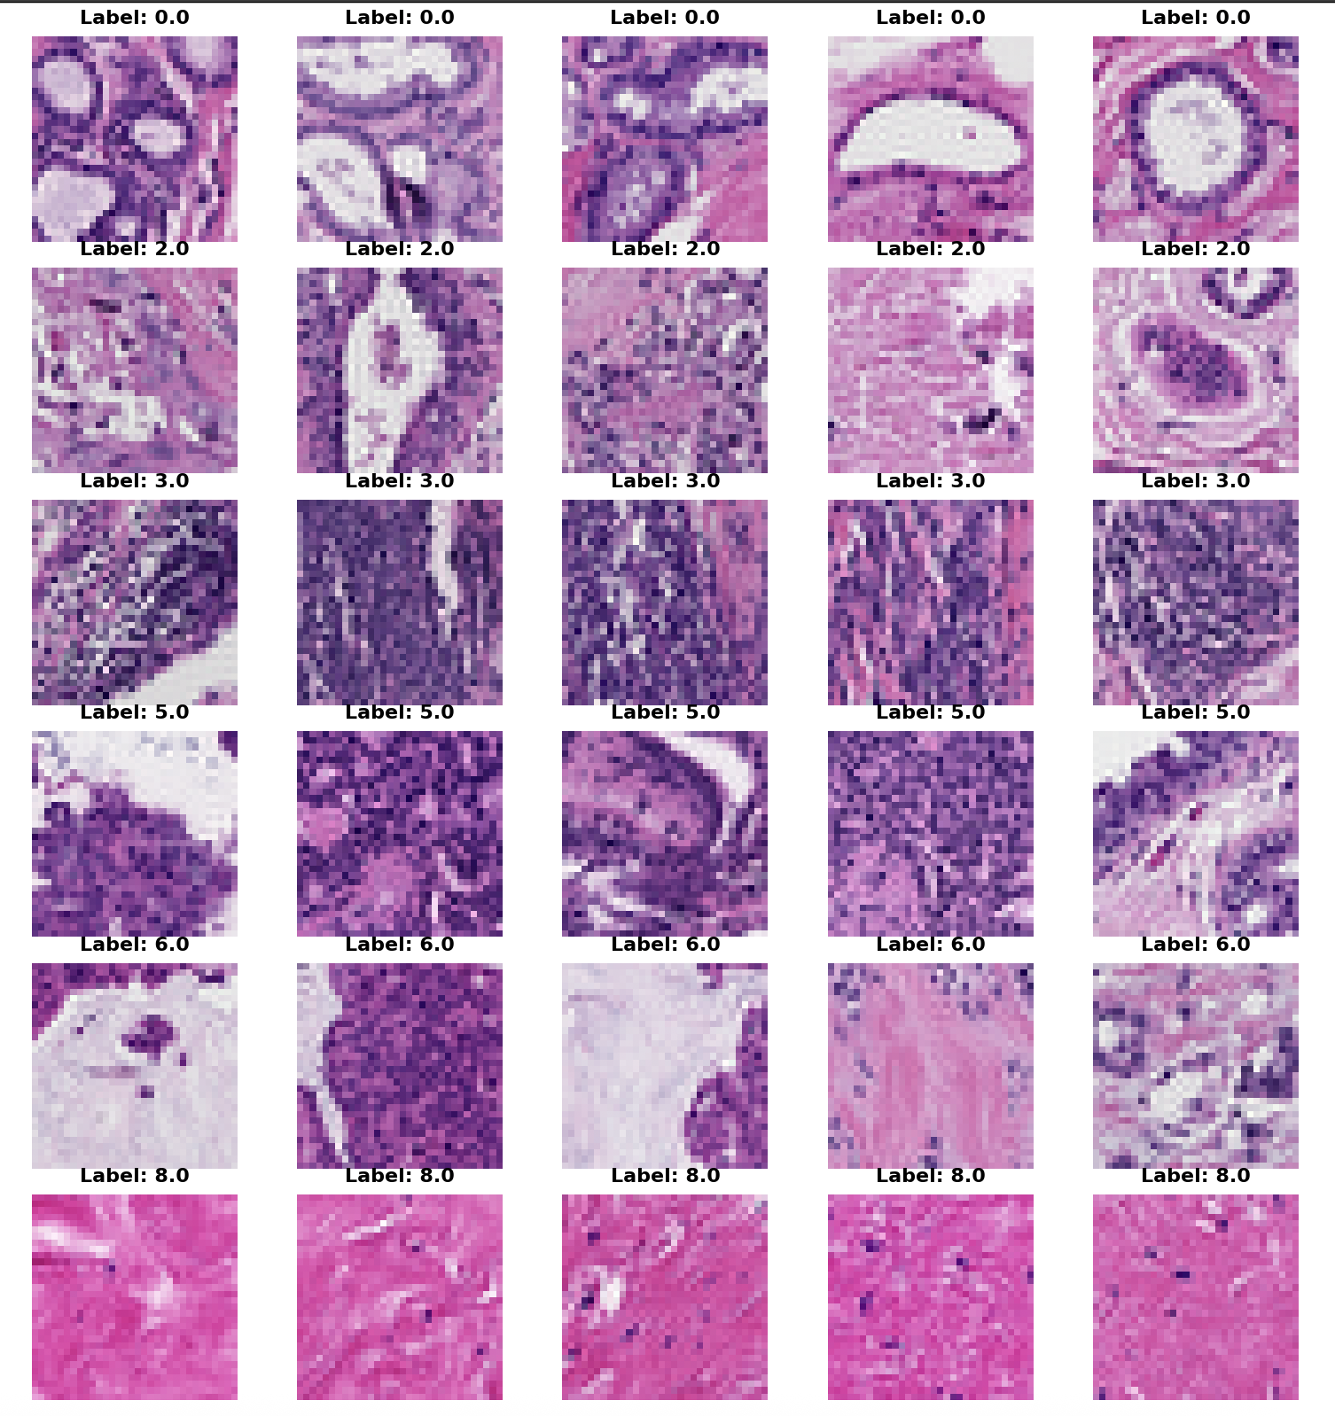
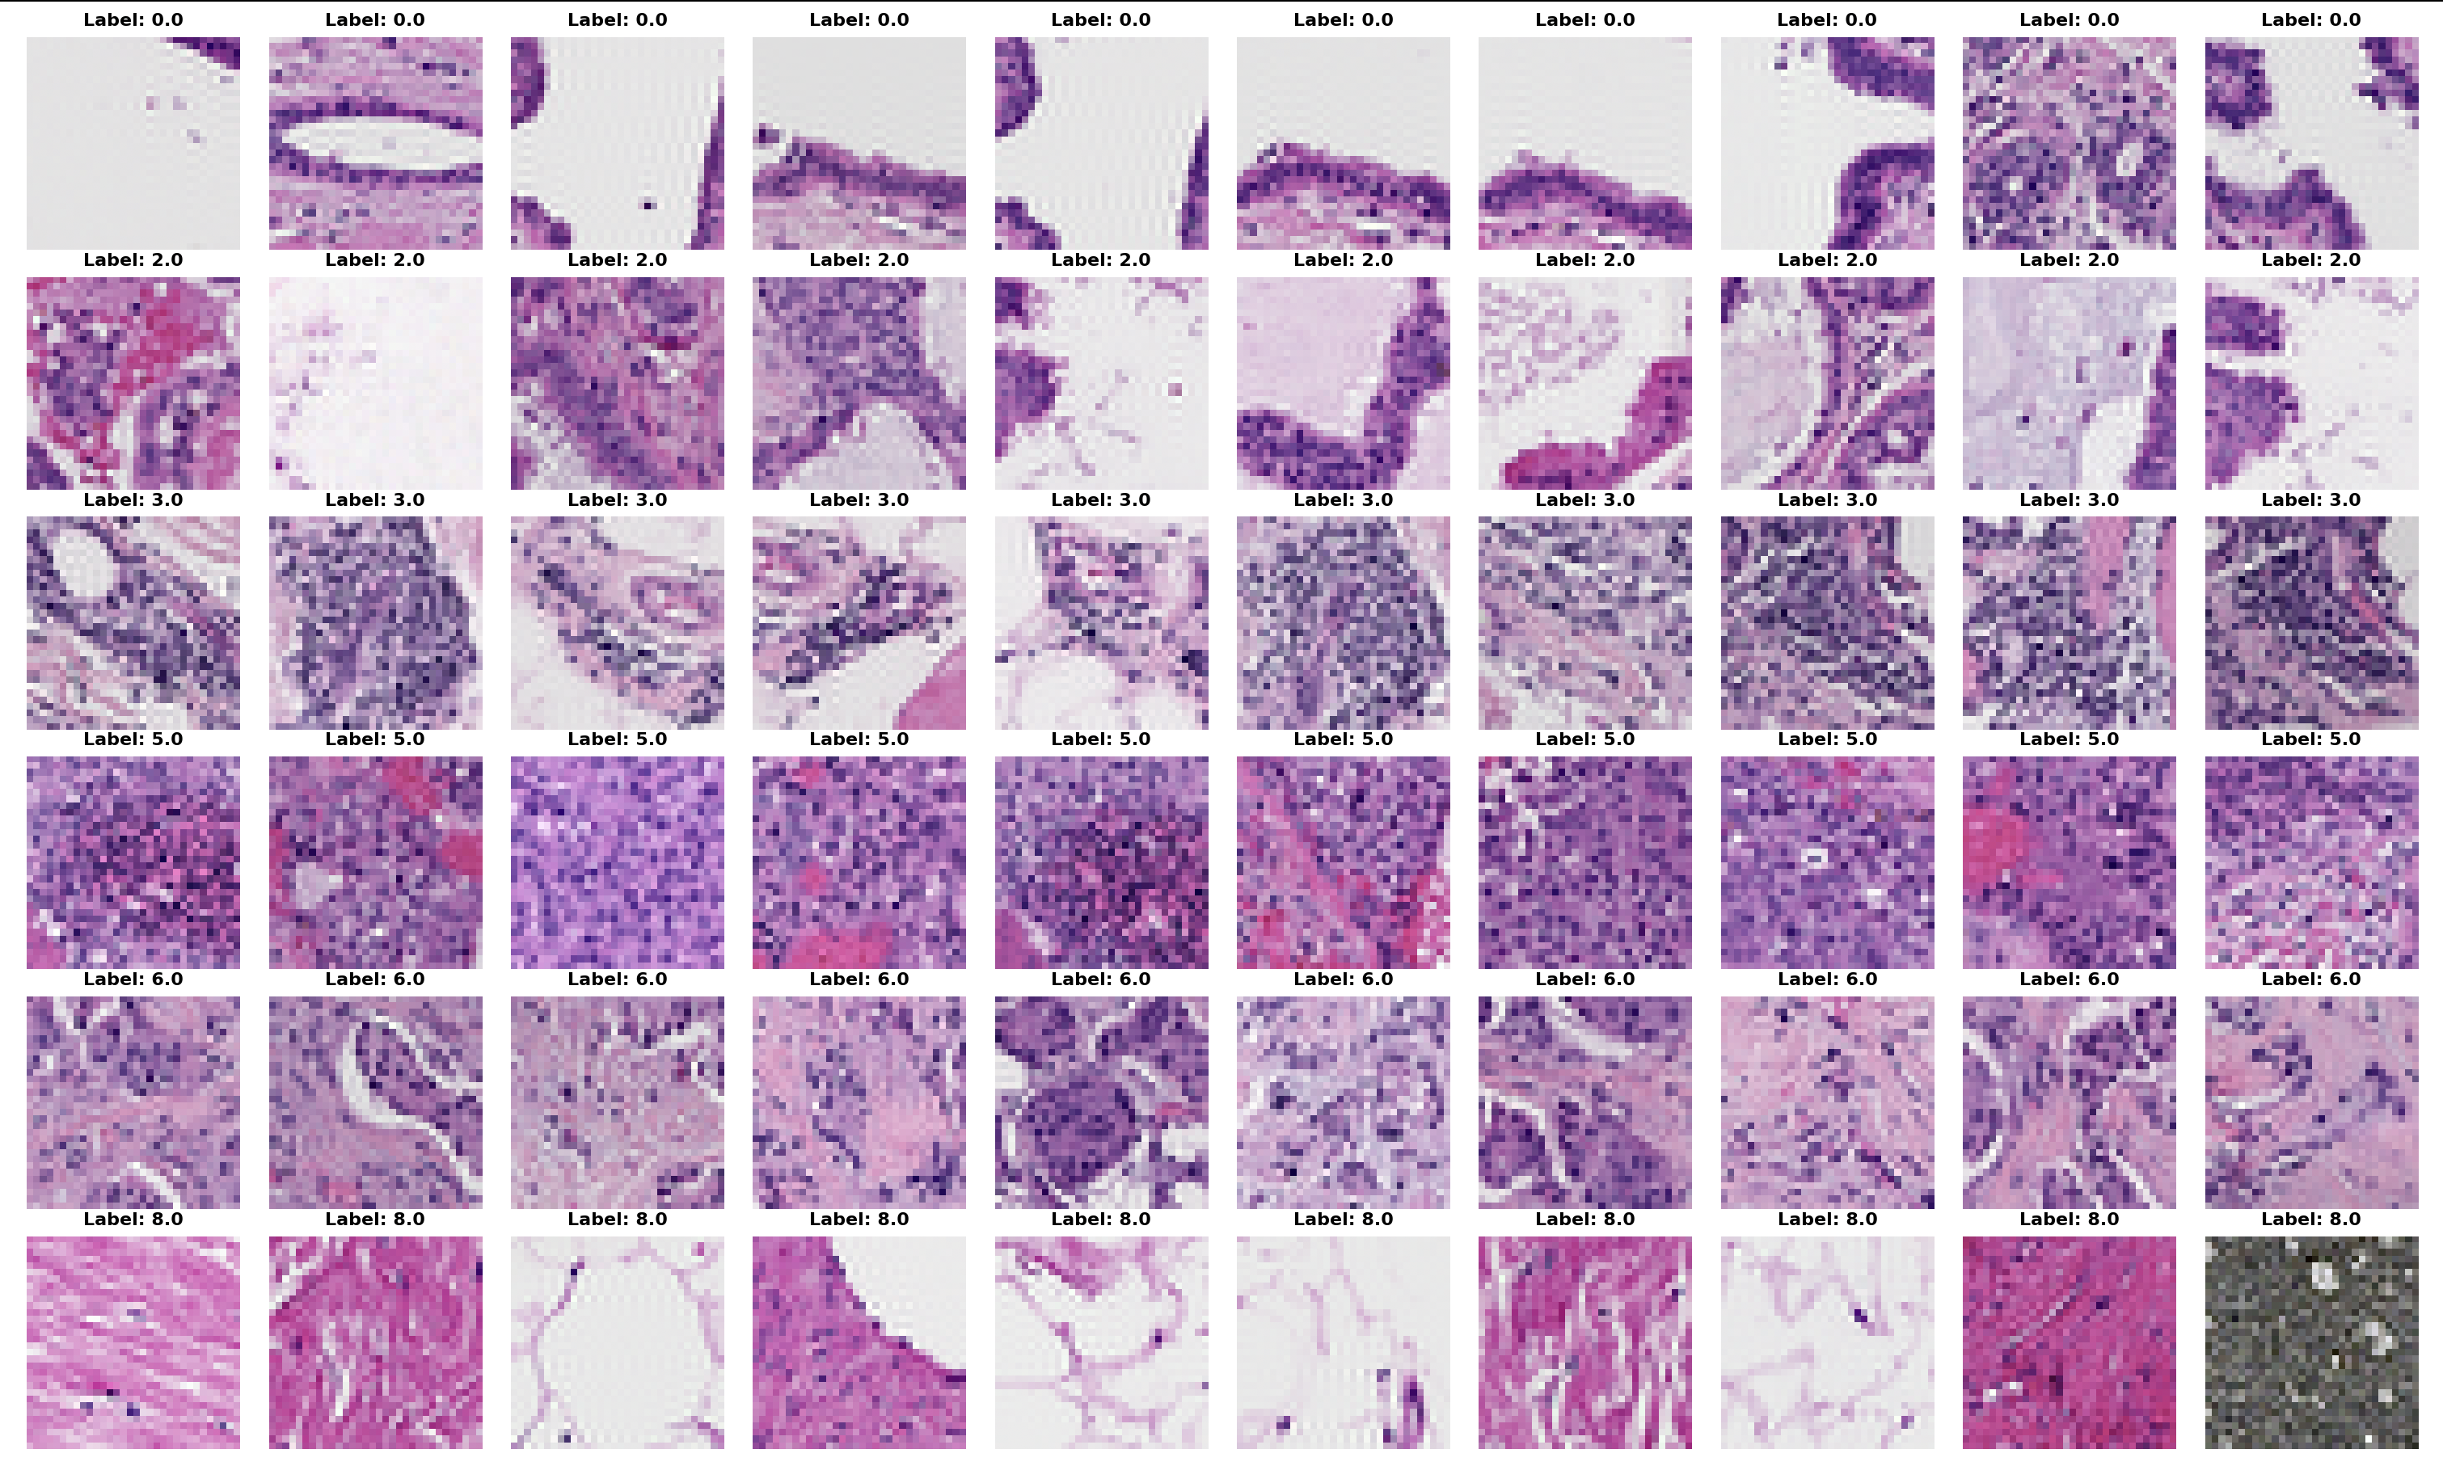
TRAINING
Dev
Notes:
0 norm
2 nneo
3 infl
5 dcis
6 invasive dcs
8 bckg

Slide 5
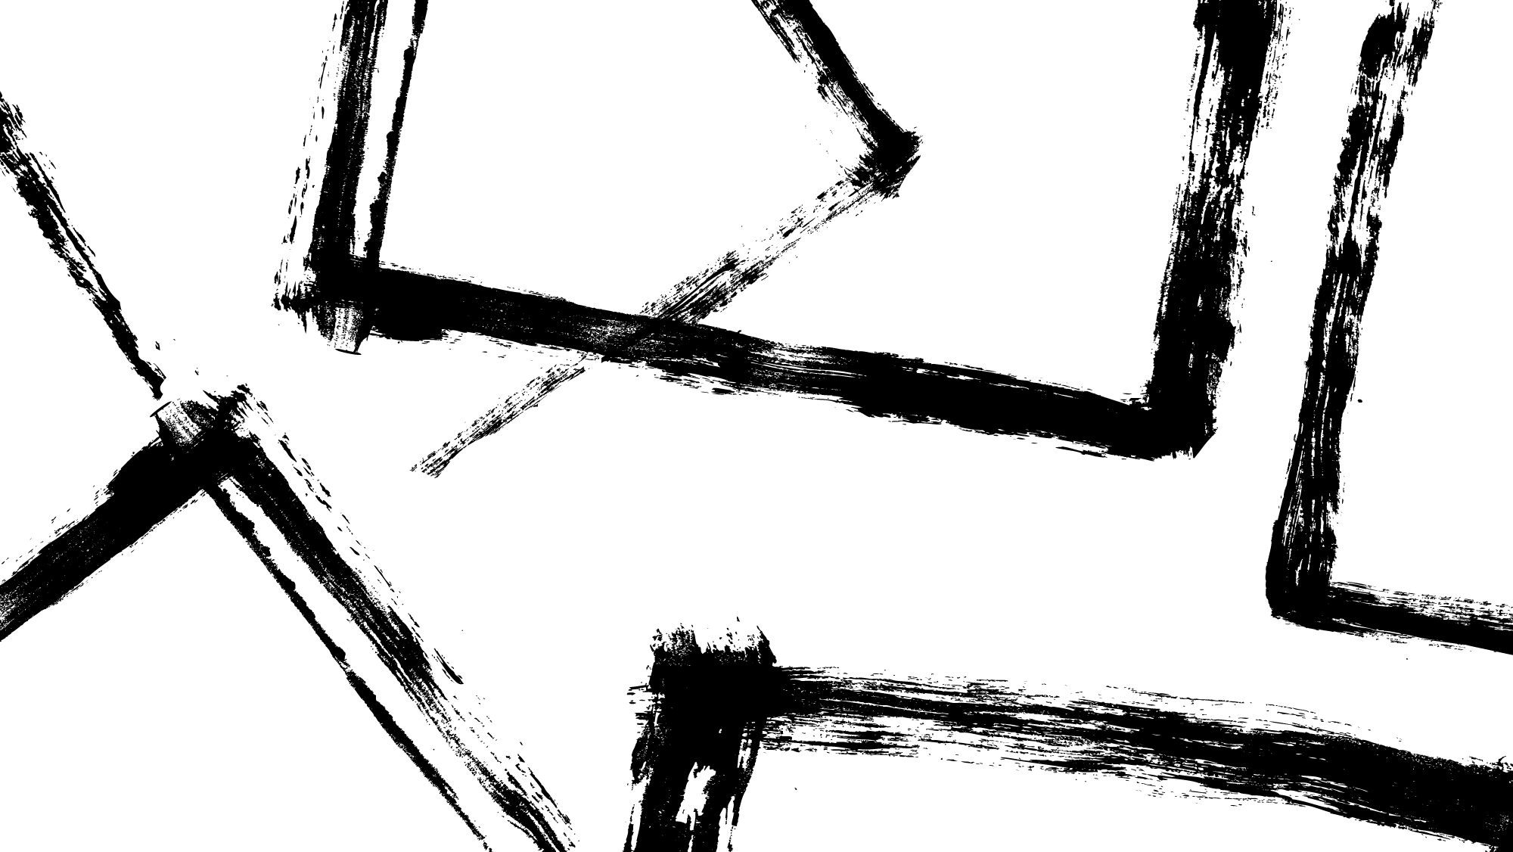
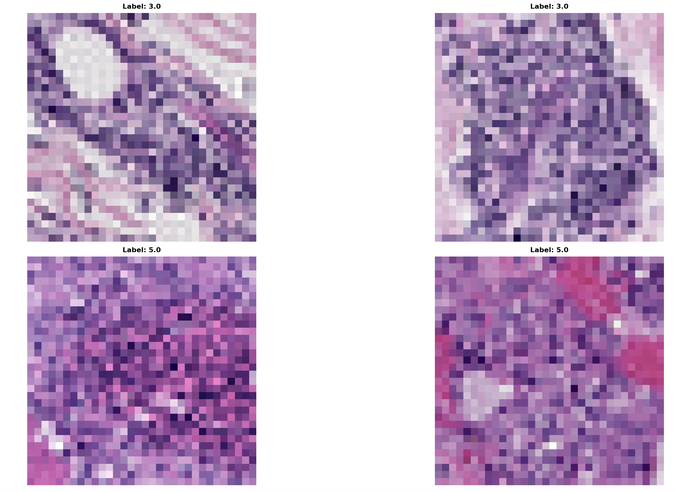
Convolutional Neural Network Architecture
Infl (3)
dcis (5)
5 Layer CNN
Increased Complexity to Classify DCIS better
Increase Kernels from 3 to 5
Normalize
Max Pooling layer
ReLU
Dropout Factor
CNN Layers
Edges and Textures
Shapes and Patterns
Objects and other parts
Whole Recognizable Structures
2 Fully connected layers for classification
Notes:
Normalize with Batch norm
bumping last layer to 0.5 rather than 0.2 or 0.3

Slide 6
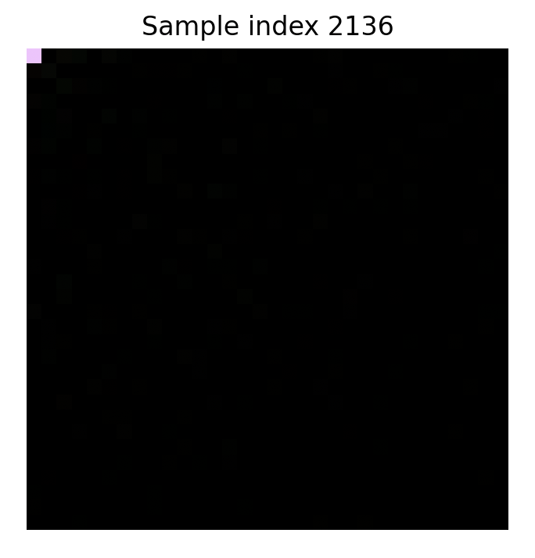
Random Forest Architecture
PARAMERTERS
Number of trees (n_estimators) number of trees
Maximum depth (max_depth) depth of trees
Minimum samples split (min_samples_split) minimum number of samples before being able to split the tree.
Minimum samples leaf (min_samples_leaf)
Max features
Class weight
Didn’t start getting good results until pooled data
Maximize the separations in different Frequency Components
Overfitting and Over Sampling
Notes:
Weird how Pooling Data together helped so much considering what it was like in our hw
Already bagging

Slide 7
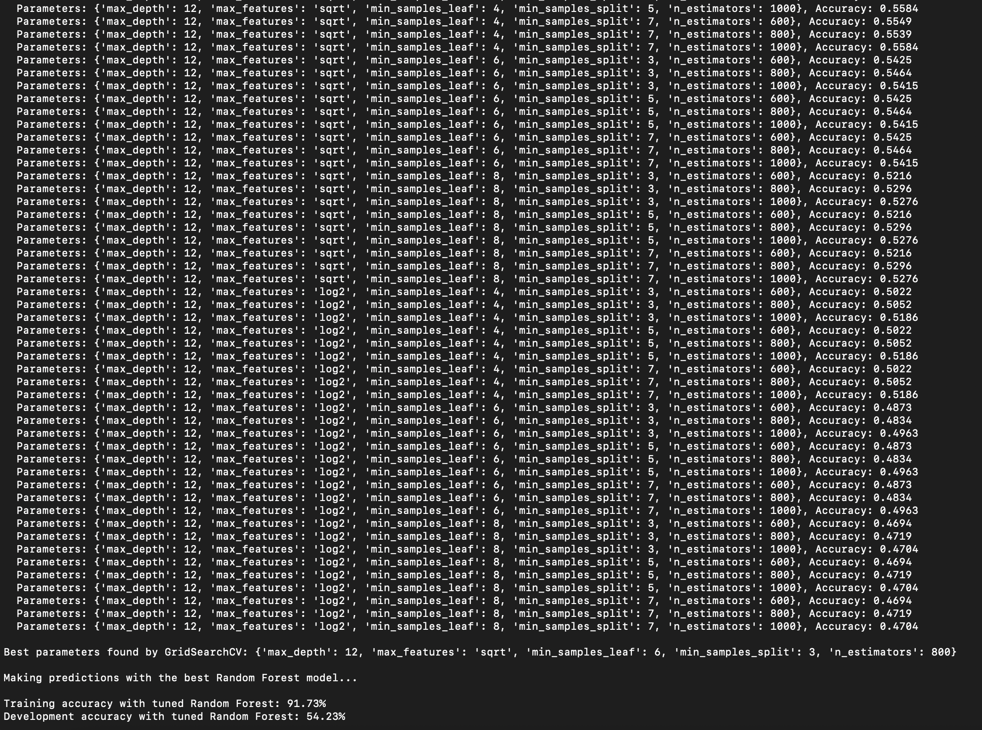

Training
CNN Computationally heavy
CNN Cross Entropy Loss
Experimented with lots of error rates
ADAM Optimizer
Goal minimize the CEL when Training
RNF Trains Fast
Ran a lot of Test cases based on Accuracy
Class weights = balance
Auto adjusted weights
Train and Dev on both to maximize data seen in Training (Better than oversampling)
Notes:
Cross Entropy loss
Had it so if it does not better within 5 passes early stop

Slide 8
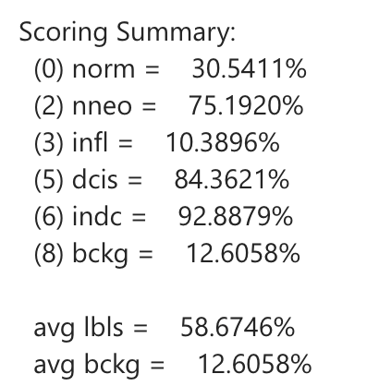
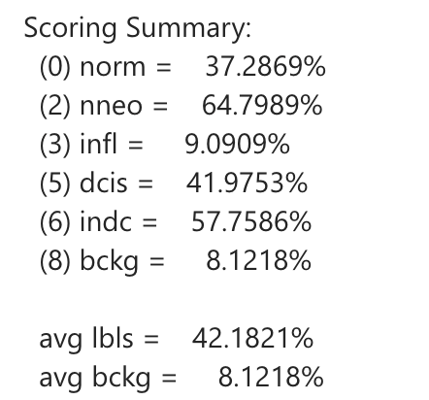
Performance on Classes
Eval Set
RNF
CNN

Slide 9
Final Results For Models
RNF Outperforms Train and Dev(Shows Overfitting)
CNN Has consistent Numbers from Training through the Eval Set
MODEL | Training: | Dev: | Eval:
CNN | 21.32% | 22.39% | 38.78%
RNF | 8.85% | 10.49% | 54.07%

Slide 10
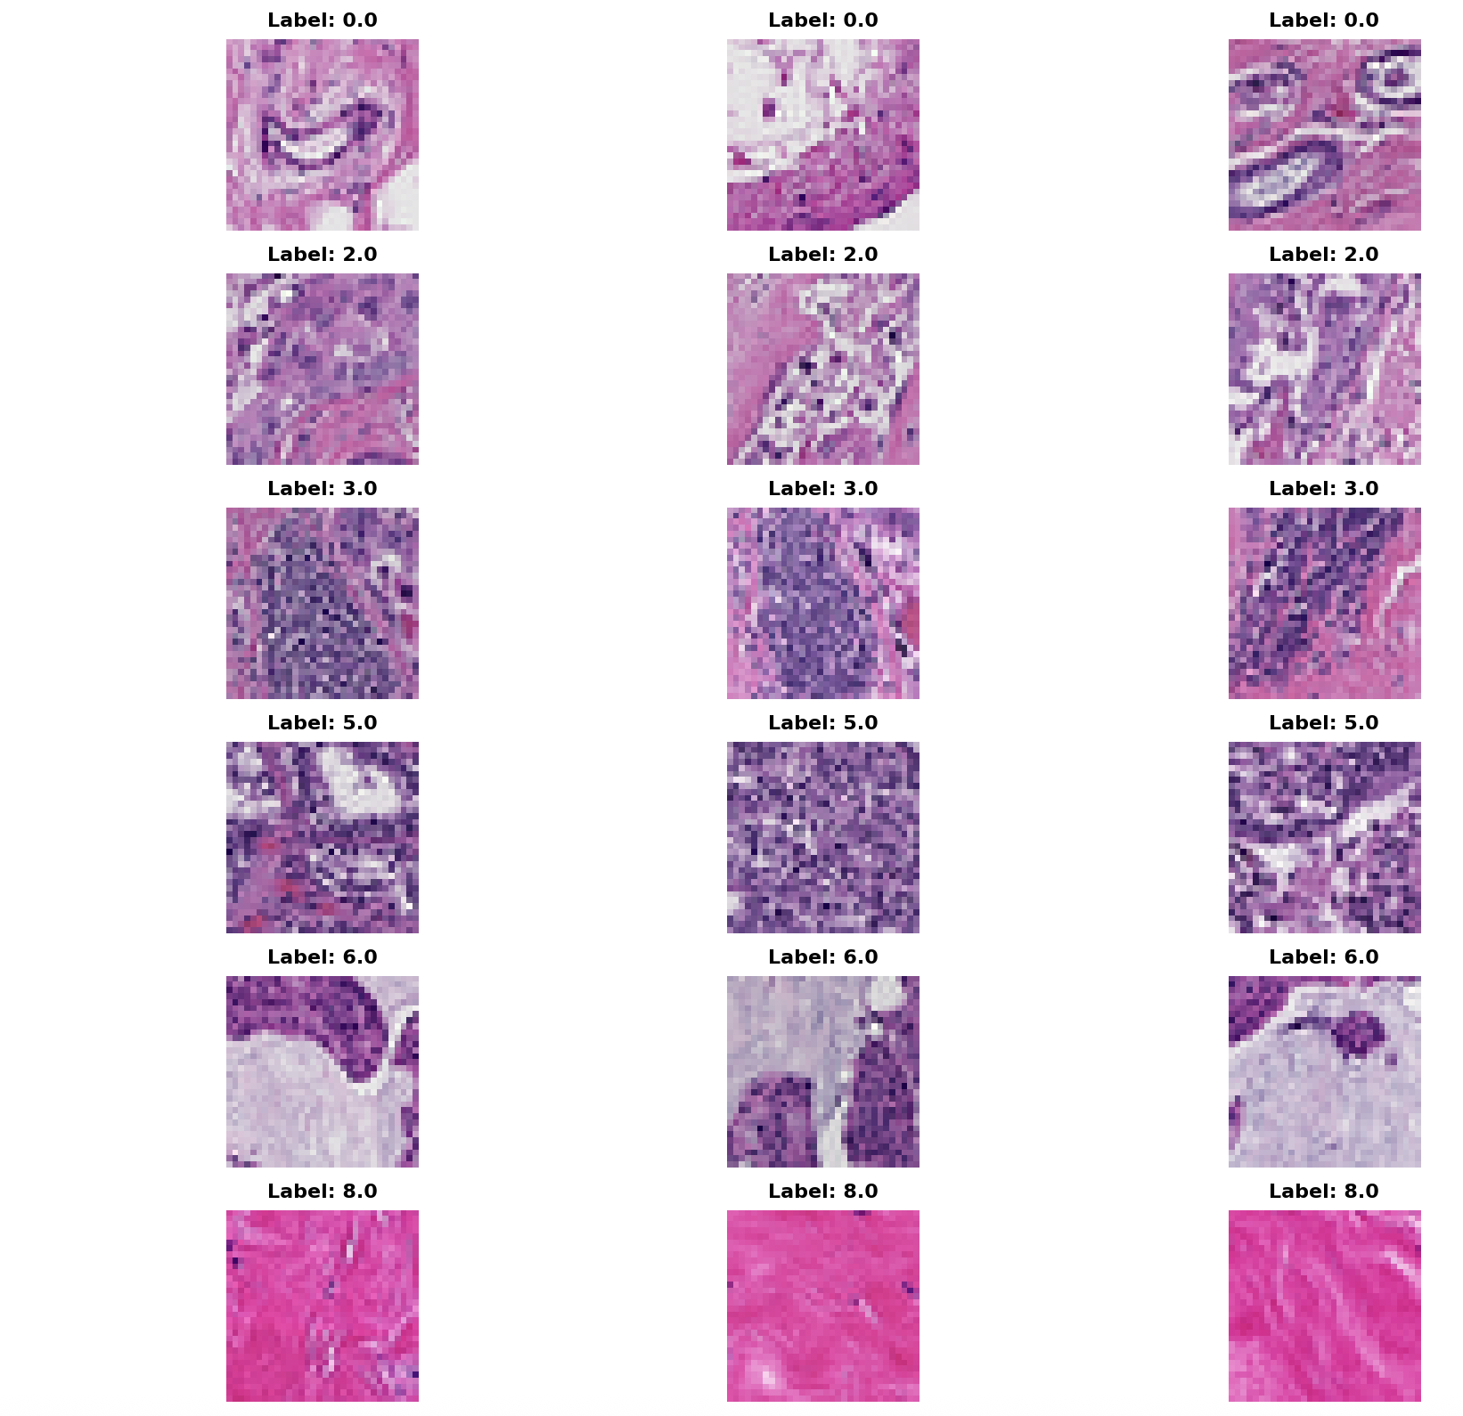
Conclusion:
CNN outperformed RNF
Both models have a hard time with different classifications
Pathologists Can use this CNN model to Quicker Identify Cancer Symptoms for patients which speeds up wait times in hospitals
As new data is collected, we can have a better understanding on how to alter features, As well as we could create a model in which uses CNN to learn on IDCT and DCT images.

